Slide 1
SENTIMENT ANALYSIS

Slide 2
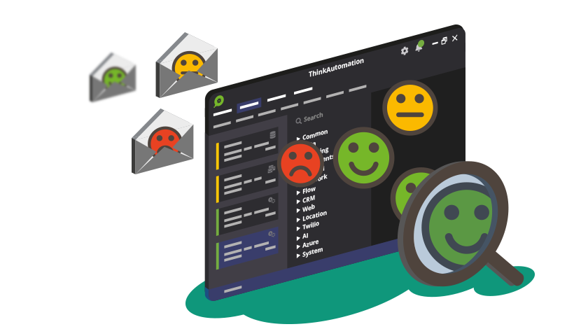
WHAT IS SENTIMENT ANALYSIS?
Positive and negative opinions are powerful because they can boost or ruin a brand’s reputation. Did you know that 40% of buyers form an opinion of a business after reading 1-3 online reviews?
This gives you an idea of how important it is to track the sentiment of conversations around your brand, whether in reviews, surveys, social media, emails, and more.
Dealing with huge amounts of data can be a struggle when done manually. But with AI techniques, like sentiment analysis, you can automatically identify the emotional tone in a text – in real time, at scale, and accurately.
It focuses not only on polarity (positive, negative & neutral) but also on emotions (happy, sad, angry, etc.).
It combines machine learning and natural language processing (NLP)* to achieve this.
Notes:
*Natural language processing (NLP) refers to the branch of computer science—and more specifically, the branch of artificial intelligence or AI—concerned with giving computers the ability to understand text and spoken words in much the same way human beings can.

Slide 3
Why perform Sentiment Analysis? (With Examples)
CUSTOMER FEEDBACK
MARKET RESEARCH
BRAND MONITORING
01
02
03
04
ASPECT-BASED SENTIMENT ANALYSIS (ABSA)
05
PREDICTIONS
Feedback through various mediums like Twitter and Facebook, uses sentiment analysis algorithms on those text snippets to understand the customers' attitude towards a product.
Sentiment analysis can help monitor online conversations about a specific marketing campaign, so you can see how it’s performing.
Sentiment analysis is an excellent tool to keep a close eye on your brand’s reputation, find out what is right or wrong about your business, and understand more about your customers.
With sentiment analysis or opinion mining , we can gather thousands of news and tweets for a company to predict its market.
can be used to analyze customer feedback by associating specific sentiments with different aspects of a product or service.

Slide 4
Types of Sentiment Analysis
Fine-grained sentiment analysis
Aspect based sentiment analysis
Emotion detection
Multilingual sentiment analysis
This depends on the polarity based. This category can be designed as very positive, positive, neutral, negative, very negative. The rating is done on the scale 1 to 5. If the rating is 5 then it is very positive, 2 then negative and 3 then neutral.
It focuses on a particular aspect like for instance, if a person wants to check the feature of the cell phone then it checks the aspect such as battery, screen, camera quality then aspect based is used.
The sentiment happy, sad, anger, upset, jolly, pleasant, and so on come under emotion detection. It is also known as a lexicon method of sentiment analysis.
Multilingual consists of different languages where the classification needs to be done as positive, negative, and neutral. This is highly challenging and comparatively difficult.

Slide 5

CHALLENGES
Sentiment analysis is one of the hardest tasks in natural language processing because even
humans struggle to analyze sentiments accurately.
Data scientists are getting better at creating more accurate sentiment classifiers, but
there’s still a long way to go. Let’s take a closer look at some of the main challenges of
machine-based sentiment analysis:

Slide 6

Subjectivity and Tone
There are two types of text: subjective and objective. Objective texts do not contain explicit
sentiments, whereas subjective texts do. Say, for example, you intend to analyze the
sentiment of the following two texts:
The package is nice.
The package is red.
Most people would say that sentiment is positive for the first one and neutral for the second
one, right? All predicates (adjectives, verbs, and some nouns) should not be treated the same
with respect to how they create sentiment. In the example above, nice is more subjective
than red.

Slide 7

Context and Polarity
All utterances are uttered at some point in time, in some place, by and to some people, you get the point.
All utterances are uttered in context. Analyzing sentiment without context gets pretty difficult. However,
machines cannot learn about contexts if they are not mentioned explicitly. One of the problems that
arise from context is changes in polarity. Look at the following responses to a survey:
Everything about it.
Absolutely nothing!
Imagine the responses above come from answers to the question What did you like about the event?
The first response would be positive and the second one would be negative, right? Now, imagine the
responses come from answers to the question What did you Dislike about the event? The negative in
the question will make sentiment analysis change altogether.
A good deal of preprocessing or postprocessing will be needed if we are to take into account at least part
of the context in which texts were produced. However, how to preprocess or postprocess data in order to
capture the bits of context that will help analyze sentiment is not straightforward.

Slide 8

Irony and Sarcasm
When it comes to irony and sarcasm, people express their negative sentiments using positive words,
which can be difficult for machines to detect without having a thorough understanding of the context of
the situation in which a feeling was expressed.
For example, look at some possible answers to the question, Did you enjoy your shopping experience with us?
Yeah, sure. So smooth!
Not one, but many!
What sentiment would you assign to the responses above? The first response with an exclamation mark
could be negative, right? The problem is there is no textual cue that will help a machine learn, or at least
question that sentiment since yeah and sure often belong to positive or neutral texts.
How about the second response? In this context, sentiment is positive, but we’re sure you can come up
with many different contexts in which the same response can express negative sentiment.

Slide 9
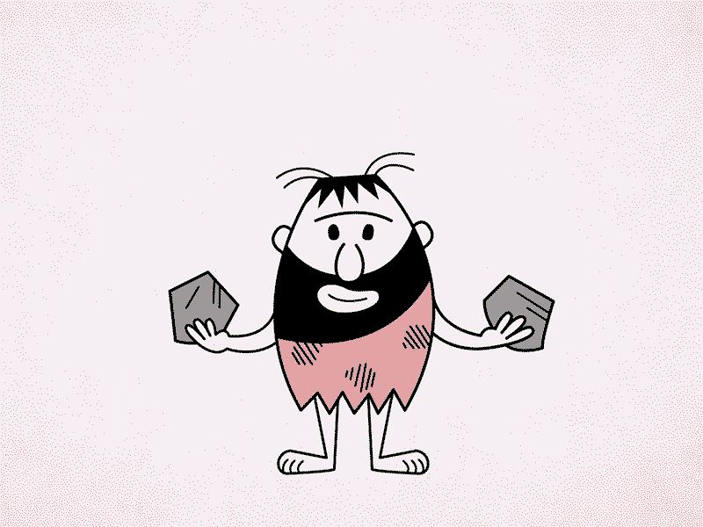
Comparisons
How to treat comparisons in sentiment analysis is another challenge worth tackling. Look at the texts
below:
This product is second to none.
This is better than older tools.
This is better than nothing.
The first comparison doesn’t need any contextual clues to be classified correctly. It’s clear that it’s
positive.
The second and third texts are a little more difficult to classify, though. Would you classify them as
neutral, positive, or even negative? Once again, context can make a difference. For example, if the ‘older
tools’ in the second text were considered useless, then the second text is pretty similar to the third text.

Slide 10

Emojis
There are two types of emojis according to Guibon et al.. Western emojis (e.g. :D) are encoded in only one
or two characters, whereas Eastern emojis (e.g. ¯ \ (ツ) / ¯) are a longer combination of characters of a
vertical nature.
Emojis play an important role in the sentiment of texts, particularly in tweets.
You’ll need to pay special attention to character-level, as well as word-level, when performing sentiment
analysis on tweets.
A lot of preprocessing might also be needed.
For example, you might want to preprocess social media content and transform both Western and
Eastern emojis into tokens and whitelist them (i.e. always take them as a feature for classification
purposes) in order to help improve sentiment analysis performance.

Slide 11

Defining Natural
Defining what we mean by neutral is another challenge to tackle in order to perform accurate sentiment
analysis. As in all classification problems, defining your categories -and, in this case, the neutral tag- is
one of the most important parts of the problem. What you mean by neutral, positive, or negative does
matter when you train sentiment analysis models. Since tagging data requires that tagging criteria be
consistent, a good definition of the problem is a must.
Here are some ideas to help you identify and define neutral texts:
🚩Objective texts: So called objective texts do not contain explicit sentiments, so you should include those texts into the neutral category.
🚩Irrelevant information: If you haven’t preprocessed your data to filter out irrelevant information, you can tag it neutral. However, be careful! Only do this if you know how this could affect overall performance. Sometimes, you will be adding noise to your classifier and performance could get worse.
🚩Texts containing wishes: Some wishes like, I wish the product had more integrations are generally neutral. However, those including comparisons like, I wish the product were better are pretty difficult to categorize

Slide 12

Human Annotator Accuracy
Sentiment analysis is a tremendously difficult task even for humans. On average, inter-annotator
agreement (a measure of how well two (or more) human labelers can make the same annotation
decision) is pretty low when it comes to sentiment analysis. And since machines learn from
labeled data, sentiment analysis classifiers might not be as precise as other types of classifiers.

Slide 13
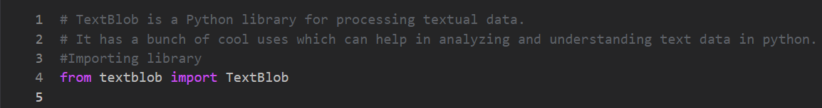
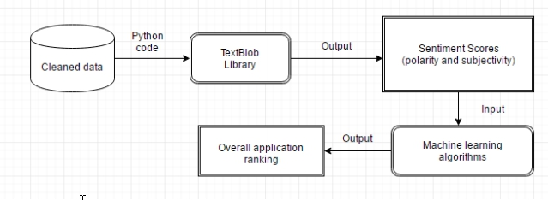

Examples
First Let’s have a look at a basic example of sentiment analysis:
1) Installing Libraries
2) Understanding the Process:

Slide 14
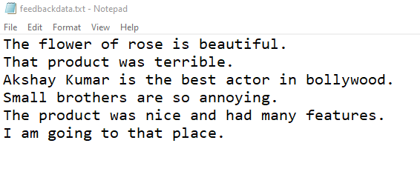
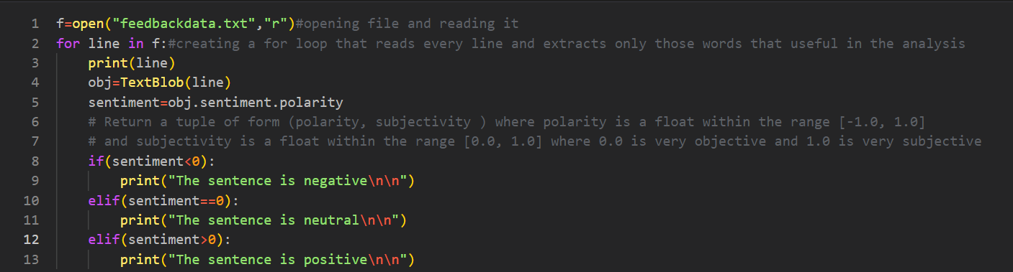
Contd…
3) Learning about the data:
4) Analyzing the sentiment of each line in the data:

Slide 15
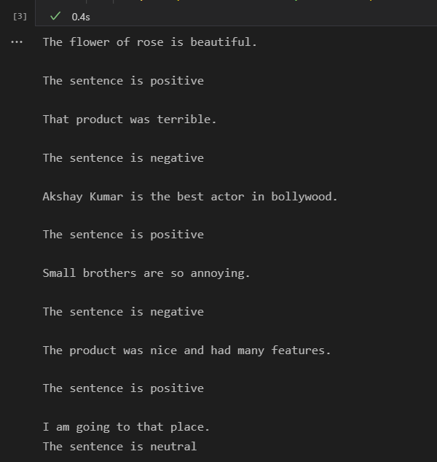
Contd…
5) Final Output:

Slide 16

Sentiment Analysis with Visualization
Now that we know the basic concept used in sentiment analysis let’s have a more deeper
and detailed look at another example:
I’m sure everyone must have heard of NETFLIX right?
Netflix is one of the largest providers of online streaming services. It collects a huge
amount of data because it has a very large subscriber base. We can analyze a lot of data
and models from Netflix because this platform has consistently focused on changing
business needs by shifting its business model from on-demand DVD movie rental and now
focusing a lot about the production of their original shows.
We’ve already learned how Sentiment Analysis is very useful when taking business-driven
decisions. So, let’s have a look at some very important models of Netflix data to
understand what’s best for their business.
Notes:
The dataset I use for the Netflix data analytics task consists of TV shows and movies streamed on Netflix as of 2019. The dataset is provided by Flixable which is an engine of third-party research available on Netflix.

Slide 17

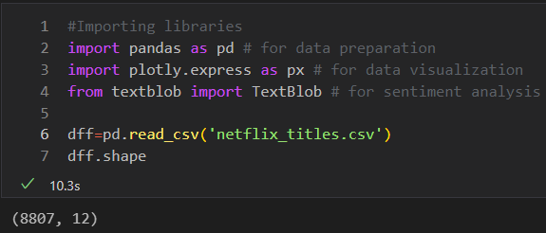
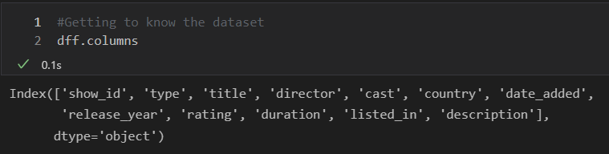
Python code
1) Importing necessary libraries:
2) Getting to know the dataset :

Slide 18
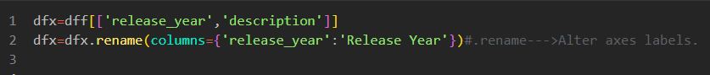
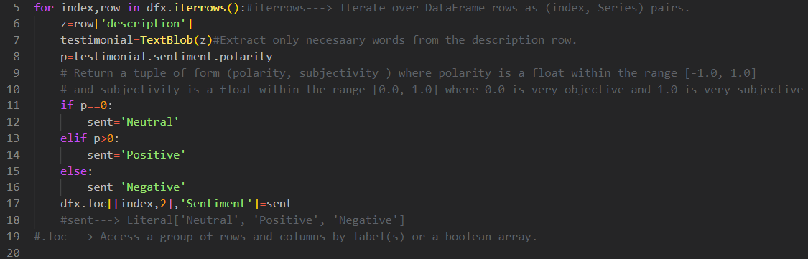
3) Getting required columns and renaming them:
4) Sentiment Analysis of the dataset:

Slide 19
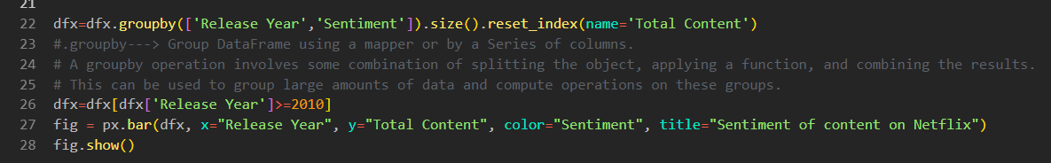
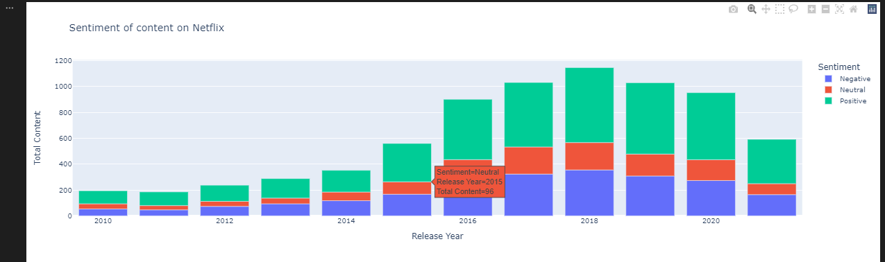
5) Plotting graph:

Slide 20

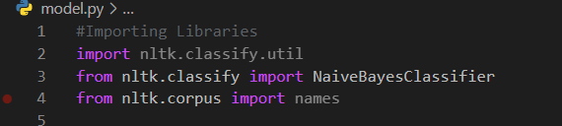
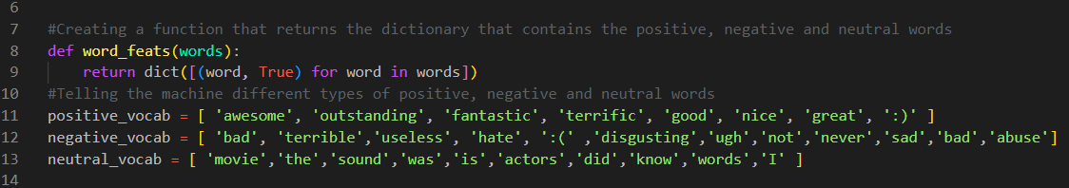
Model Creation
We can also create a simple model that can predict the positivity and the negativity of a
sentence entered by the user. Let’s have a look at the model:
1) Importing necessary libraries:
2) List of positive, negative and neutral words

Slide 21
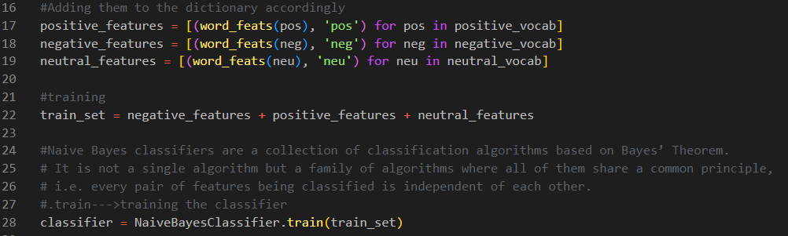
3) Training:

Slide 22
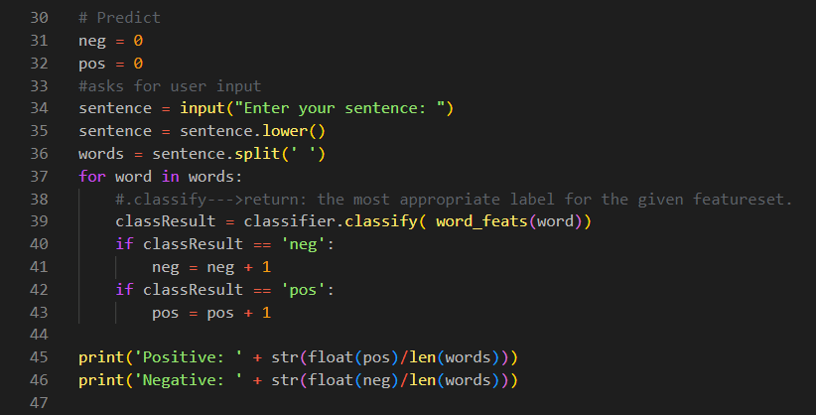
4) Prediction and output:

Slide 23
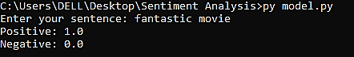
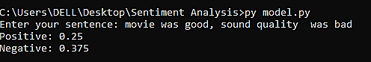
5) Final output:

Slide 24

Conclusion
State-of-the-art technologies in NLP allow us to analyze natural languages on different layers: from
simple segmentation of textual information to more sophisticated methods of sentiment
categorizations.
The algorithms of sentiment analysis mostly focus on defining opinions, attitudes, and even
emoticons in a corpus of texts.
Sentiment analysis can be applied to countless aspects of business, from brand monitoring and
product analytics, to customer service and market research. By incorporating it into their existing
systems and analytics, leading brands (not to mention entire cities) are able to work faster, with
more accuracy, toward more useful ends.
Ultimately, sentiment analysis enables us to glean new insights, better understand our customers,
and empower our own teams more effectively so that they do better and more productive work.

Slide 25
THANK YOU

